Slide 1
First Order Logic
Md Mehrab Hossain Opi
CSE 4109: Artificial Intelligence

Slide 2
Properties of Good Representation Languages
Declarative: Separates knowledge from inference.
Compositional: meaning of whole = function of parts.
Expressive: able to represent general laws, partial info.
Propositional logic has the first two.
FOL adds expressiveness by modelling objects and relations.

Slide 3
Representation Revisited
Programming Language
Can represent facts. (data structure)
Lacks any general mechanism for deriving facts.
Lacks expressiveness required to handle partial information.

Slide 4
Representation Revisited
Propositional Logic
Strengths: declarative, compositional, truth-based.
Weakness:
Can’t represent general rules concisely.
In Wumpus world must write Breeze-Pit rule per square.

Slide 5
Representation Revisited
Natural Language
Very expressive, used for communication.
Problems:
Context dependence → “Look!” meaningless without situation.
Ambiguity → “spring” (season vs. coil).
So natural language is not suitable as a direct representation for machines.

Slide 6
Combining Best of Both Worlds
Take from propositional logic:
Declarative, compositional, unambiguous foundation.
Take from natural language:
Objects (people, numbers, pits, squares).
Relations/Properties (owns, bigger than, adjacent).
Functions (father of, one more than).
Almost all knowledge fits into this framework.

Slide 7
FOL Example
‘One plus Two equals Three’
Objects: one, two, three, one plus two.
Relation: equals.
Function: plus.
‘Squares neighboring the Wumpus are smelly’
Objects: Wumpus, squares.
Property: smelly.
Relation: neighboring.

Slide 8
Why FOL Matters
Much more expressive than propositional logic.
Can represent general laws and structured knowledge.
Foundation of math, philosophy, and AI reasoning.
Lets agents represent and reason about the real world.

Slide 9
Models in Logic
A model = formal structure = a possible world.
Propositional logic: model = assign truth values to symbols.
First-order logic: model = objects + relations among them.

Slide 10
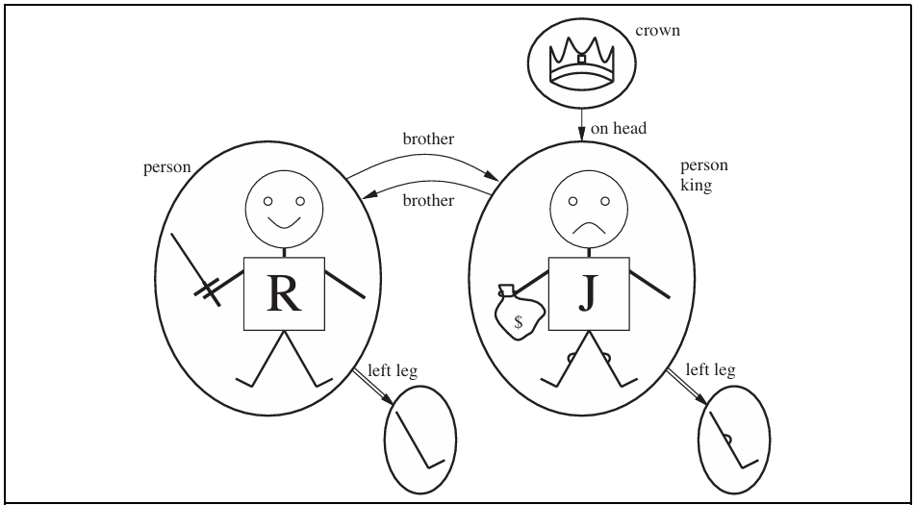
FOL Model Example
Objects:
Richard the Lionheart.
His younger brother, the Evil King John.
The left legs of Richard and John.
A crown.

Slide 11
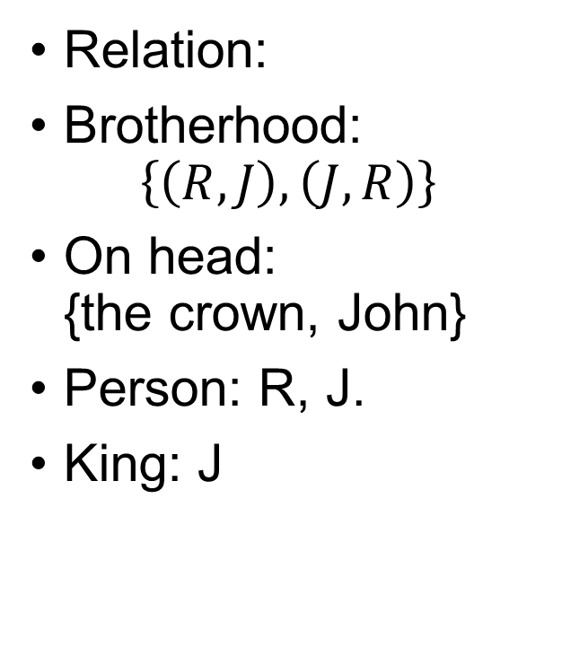
FOL Model Example
Relation:
Brotherhood: $\left\{\left(R, J\right), \left(J,R\right)\right\}$
On head: {the crown, John}
Person: R, J.
King: J

Slide 12
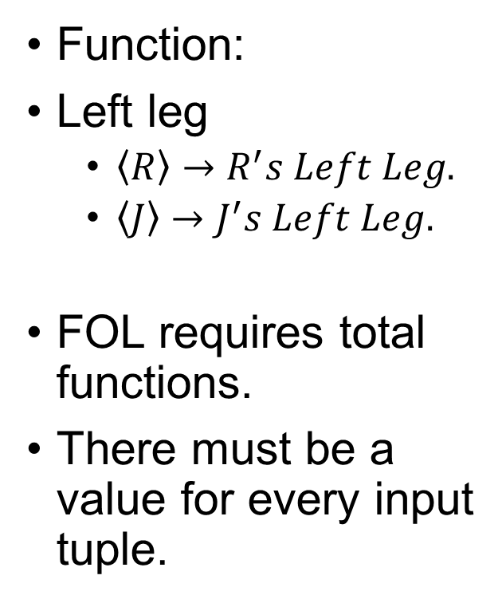
FOL Model Example
Function:
Left leg
$\left\langle R\right\rangle →R^{′}s Left Leg.$
$\left\langle J\right\rangle →J^{′}s Left Leg.$
FOL requires total functions.
There must be a value for every input tuple.

Slide 13
Linking Vocabulary to Model
Logical symbols map to objects, relations, functions in the model.
This mapping lets us evaluate truth of sentences.

Slide 14
Symbols in FOL
Constant symbols → objects (e.g., Richard, John).
Predicate symbols → relations/properties (e.g., Brother, King, OnHead).
Function symbols → mappings (e.g., LeftLeg, MotherOf).
Arity: number of arguments a predicate/function takes.

Slide 15
Interpretation
A model must interpret all symbols.
Example (intended interpretation):
Richard ↦ Richard the Lionheart
Brother ↦ brotherhood relation
LeftLeg ↦ mapping person → leg
Many other interpretations are possible!
Richard could map to the crown.
Both Richard & John could refer to the same object.

Slide 16
Sentences in FOL
Built from terms (constants, variables, functions).
Atomic sentences: Predicate(Term,...), e.g. Brother(Richard, John).
Complex sentences: connectives (¬, ∧, ∨, ⇒, ⇔).
Quantifiers: ∀x (for all x), ∃x (there exists x).

Slide 17
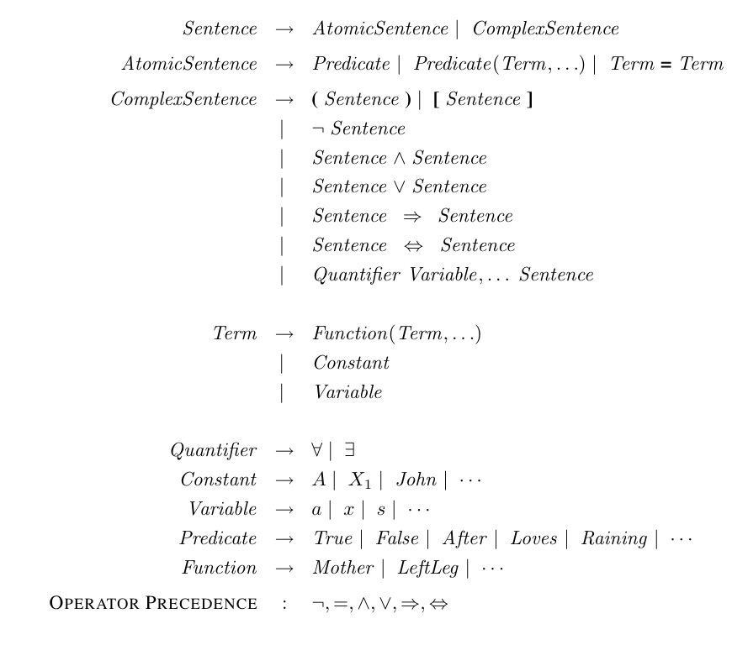
Grammar of FOL

Slide 18
Terms
A term is a logical expression that refers to an object.
Types of terms:
Constant: John
Variable: x
Function application: LeftLeg(John)
Complex term
A complex term is formed by a function symbol followed by a parenthesized list of terms as arguments to the function symbol.

Slide 19

Semantics of Terms
Term $f(t₁,…,t_{n}):$
f ↦ some function F in model.
$t₁,…,t_{n}$ ↦ objects $d₁,…,d_{n}$.
$f(t₁,…,t_{n}) ↦ F(d₁,…,d_{n}).$

Slide 20
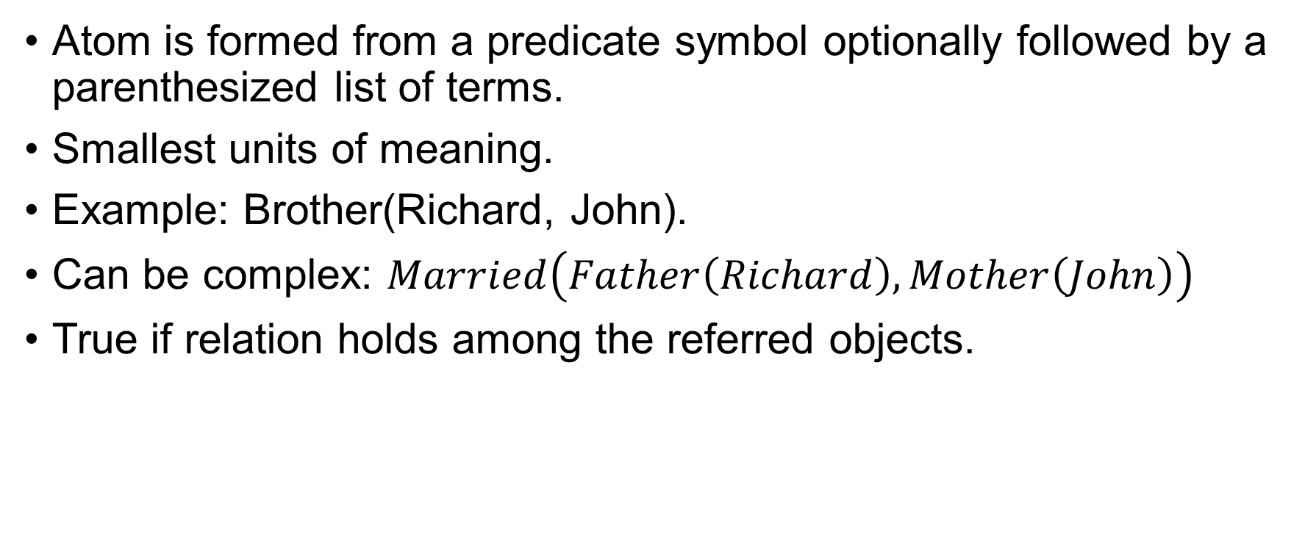
Atomic Sentences
Atom is formed from a predicate symbol optionally followed by a parenthesized list of terms.
Smallest units of meaning.
Example: Brother(Richard, John).
Can be complex: $Married\left(Father\left(Richard\right), Mother\left(John\right)\right)$
True if relation holds among the referred objects.

Slide 21
Complex Sentences
Built with connectives (¬, ∧, ∨, ⇒, ⇔).
Example sentences true in model:
¬Brother(LeftLeg(Richard), John)
King(Richard) ∨ King(John)
¬King(Richard) ⇒ King(John)

Slide 22
Quantifiers
Express properties of entire collection of objects without referring them by name.
Universal (∀): “for all”.
Existential (∃): “there exists”.
Allow generalization over domain.

Slide 23
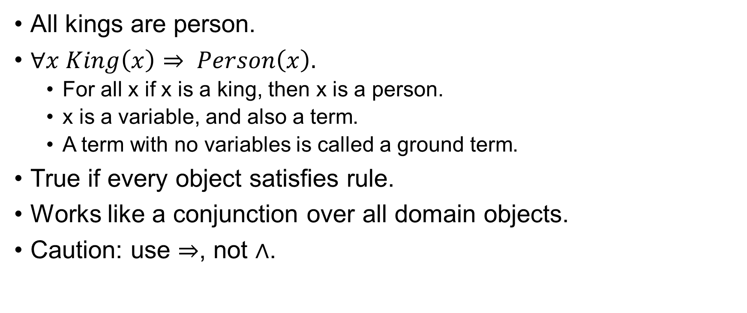
Universal Quantification
All kings are person.
$∀x King\left(x\right)⇒ Person\left(x\right).$
For all x if x is a king, then x is a person.
x is a variable, and also a term.
A term with no variables is called a ground term.
True if every object satisfies rule.
Works like a conjunction over all domain objects.
Caution: use ⇒, not ∧.

Slide 24
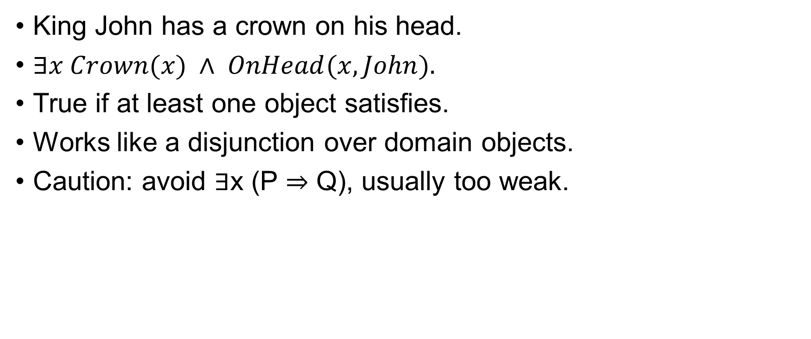
Existential Quantification
King John has a crown on his head.
$∃x Crown(x) ∧ OnHead(x, John).$
True if at least one object satisfies.
Works like a disjunction over domain objects.
Caution: avoid ∃x (P ⇒ Q), usually too weak.

Slide 25
Nested Quantifiers
Order matters!
∀x ∃y Loves(x,y) → everybody loves somebody.
∃y ∀x Loves(x,y) → there’s somebody loved by everyone.
Use different variable names to avoid confusion.

Slide 26
Connections Between ∀ and ∃
Everyone likes ice cream means that there is no one who does not like ice cream.
Duality through negation:
∀x P ≡ ¬∃x ¬P
∃x P ≡ ¬∀x ¬P
Analogy:
∀ ≈ big AND
∃ ≈ big OR

Slide 27
Equality
Extra atomic form:
Term1 = Term2.
True if both terms refer to same object.
Example: Father(John) = Henry.
Can express uniqueness:
∃x,y Brother(x,Richard) ∧ Brother(y,Richard) ∧ x ≠ y.

Slide 28

Limits of Standard Semantics
Example: “Richard’s brothers are John and Geoffrey.”
Needs cumbersome FOL:
$Brother\left(John,R\right)∧ Brother\left(Geoffrey,R\right)∧John ≠ Geoffrey ∀x∧Brother(x,R) ⇒ (x=John ∨ x=Geoffrey)$

Slide 29
Alternative: Database Semantics
Unique-names assumption: each constant is a distinct object.
Closed-world assumption: unknown facts = false.
Domain closure: only objects named by constants exist.
Makes FOL more concise (but less general).

Slide 30
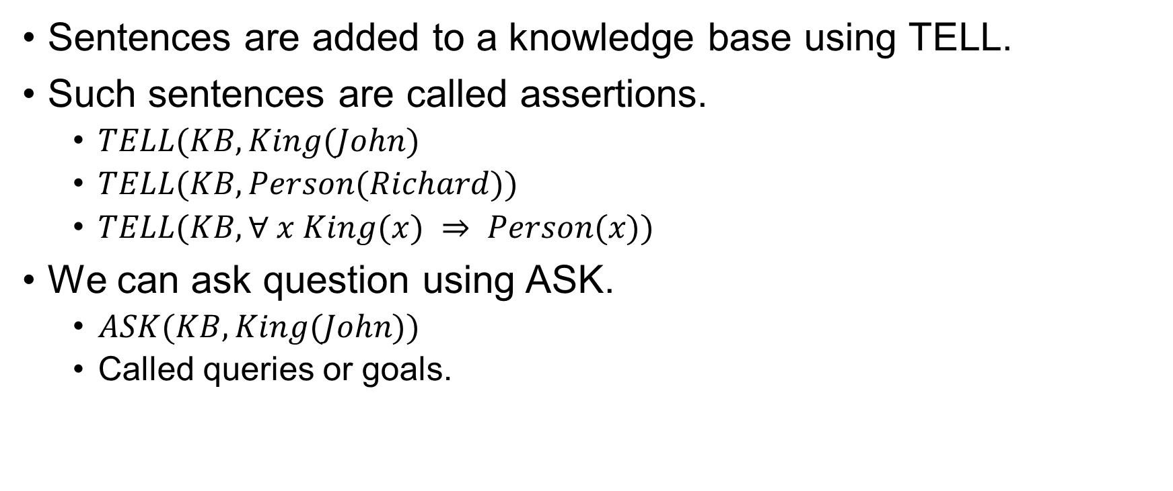
Using FOL
Sentences are added to a knowledge base using TELL.
Such sentences are called assertions.
$TELL(KB, King(John)$
$TELL(KB, Person(Richard))$
$TELL(KB, ∀ x King(x) ⇒ Person(x))$
We can ask question using ASK.
$ASK(KB, King(John))$
Called queries or goals.

Slide 31
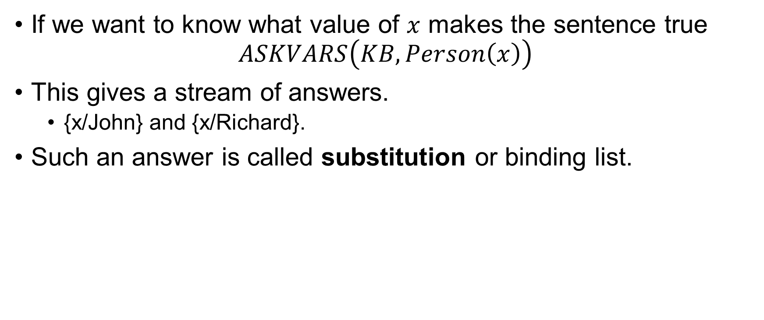
Using FOL
If we want to know what value of $x$ makes the sentence true $ASKVARS\left(KB, Person\left(x\right)\right)$
This gives a stream of answers.
{x/John} and {x/Richard}.
Such an answer is called substitution or binding list.

Slide 32
The kinship Domain
Domain of family relationships.
Elizabeth is the mother of Charles.
Charles is the father of William.
One’s grandmother is the mother of one’s parent.
Objects are people.
Two unary predicates, Male and Female.
Relations are represented by binary predicate.
Parent, Sibling, Brother, Sister, Child, Daughter, and so on.

Slide 33
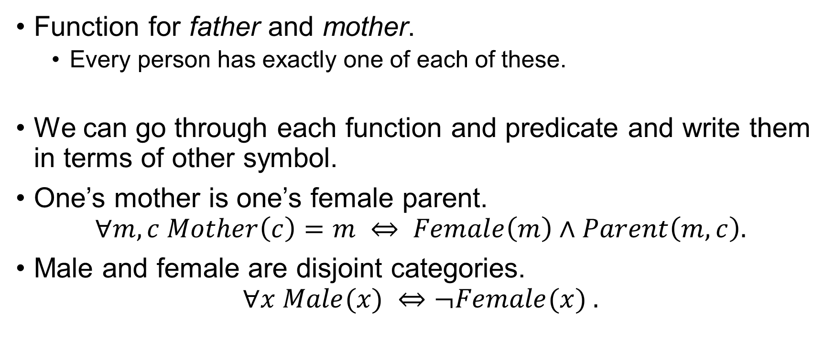
The kinship Domain
Function for father and mother.
Every person has exactly one of each of these.
We can go through each function and predicate and write them in terms of other symbol.
One’s mother is one’s female parent.
$$∀m,c Mother\left(c\right)=m ⇔ Female\left(m\right)∧Parent\left(m,c\right).$$
Male and female are disjoint categories. $∀x Male(x) ⇔¬Female(x) .$

Slide 34
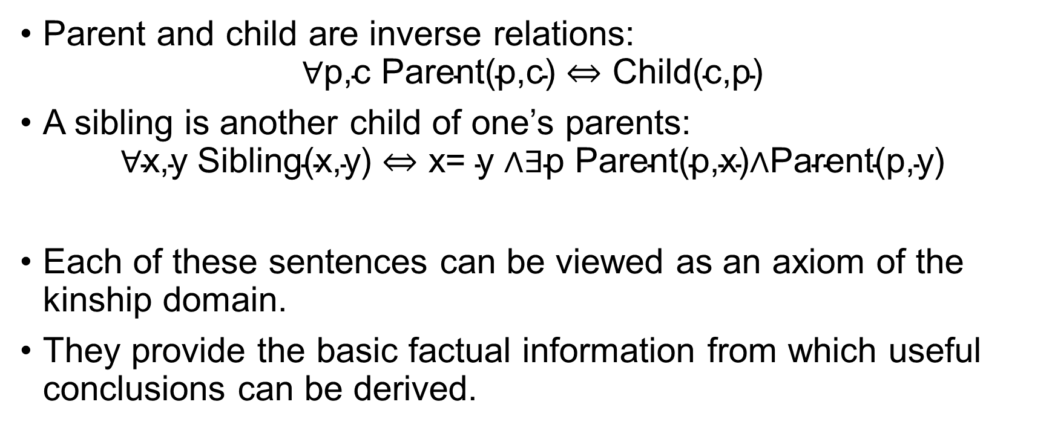
The kinship Domain
Parent and child are inverse relations: $\text{∀}\text{p}\text{,}\text{c} \text{Parent}\text{(}\text{p}\text{,}\text{c}\text{) ⇔ }\text{Child}\text{(}\text{c}\text{,}\text{p}\text{)}$
A sibling is another child of one’s parents: $\text{∀}\text{x}\text{,}\text{y} \text{Sibling}\text{(}\text{x}\text{,}\text{y}\text{) ⇔ }\text{x}\text{= }\text{y}\text{ ∧∃}\text{p} \text{Parent}\text{(}\text{p}\text{,}\text{x}\text{)∧}\text{Parent}\text{(}\text{p}\text{,}\text{y}\text{)}$
Each of these sentences can be viewed as an axiom of the kinship domain.
They provide the basic factual information from which useful conclusions can be derived.

Slide 35
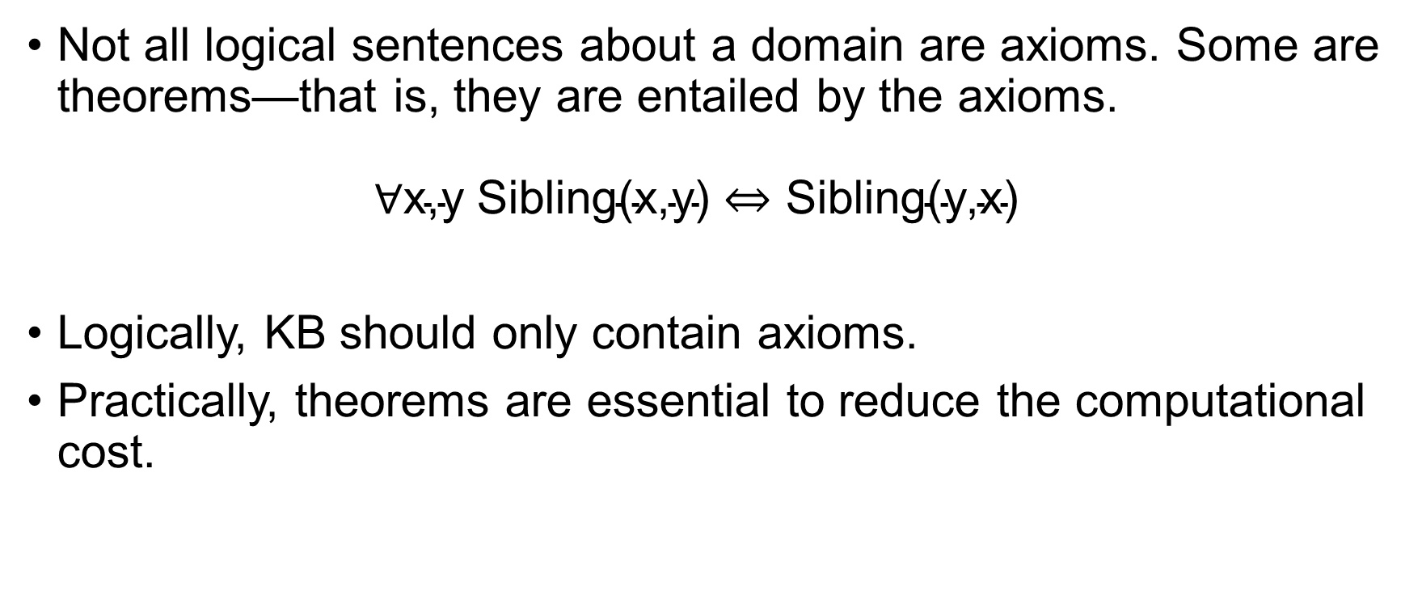
The kinship Domain
Not all logical sentences about a domain are axioms. Some are theorems—that is, they are entailed by the axioms. $\text{∀}\text{x}\text{,}\text{y} \text{Sibling}\text{(}\text{x}\text{,}\text{y}\text{) ⇔ }\text{Sibling}\text{(}\text{y}\text{,}\text{x}\text{)}$
Logically, KB should only contain axioms.
Practically, theorems are essential to reduce the computational cost.

Slide 36
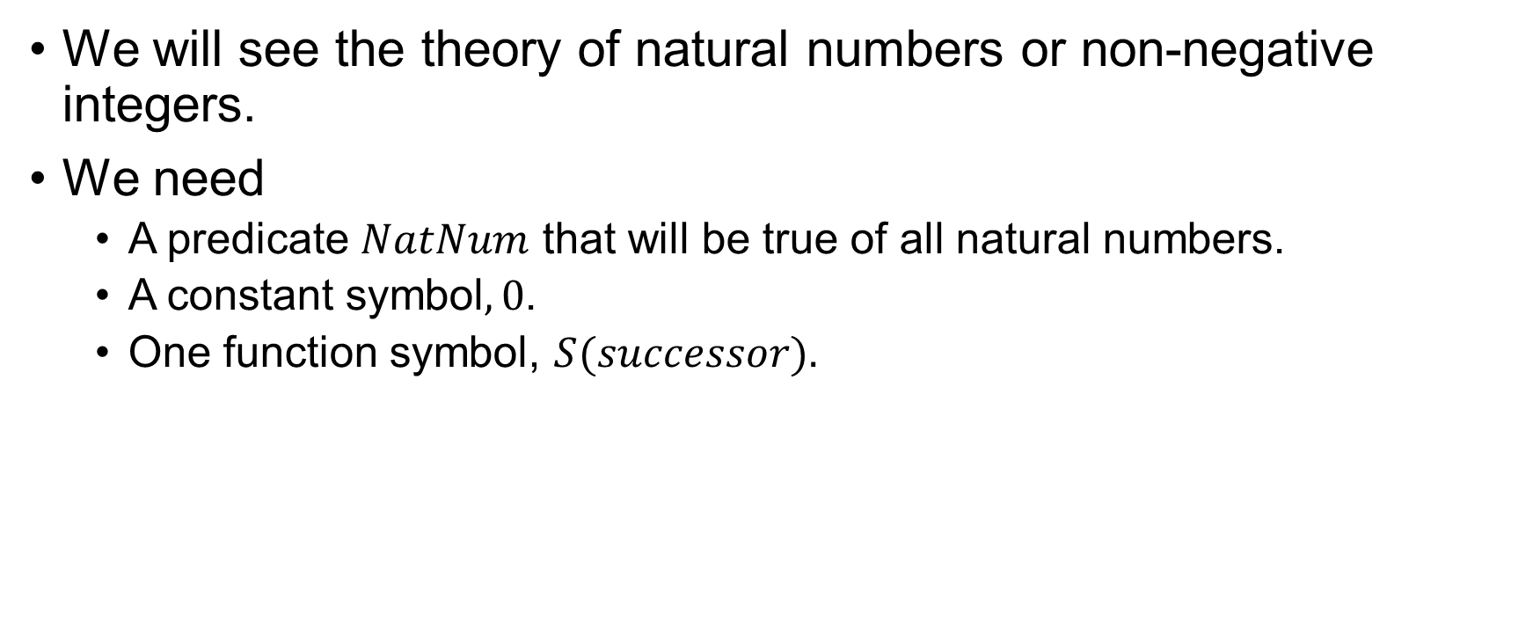
Numbers
We will see the theory of natural numbers or non-negative integers.
We need
A predicate $NatNum$ that will be true of all natural numbers.
A constant symbol$, 0$.
One function symbol, $S(successor).$

Slide 37
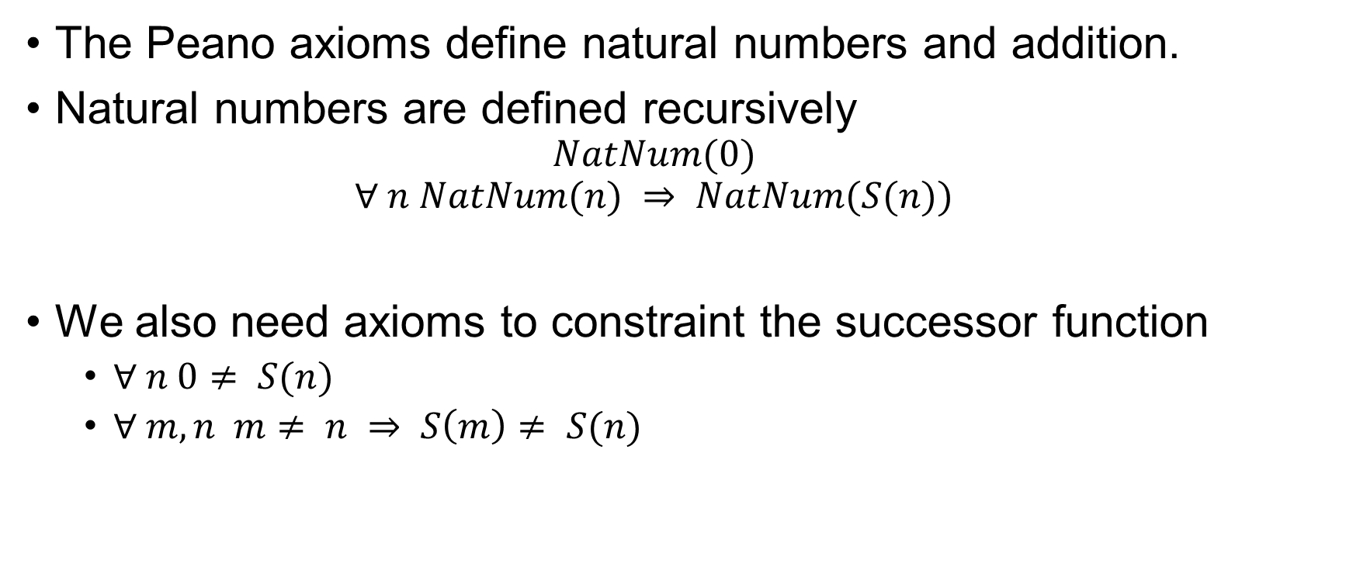
Numbers
The Peano axioms define natural numbers and addition.
Natural numbers are defined recursively
$$NatNum(0)$$
$$∀ n NatNum(n) ⇒ NatNum(S(n))$$
We also need axioms to constraint the successor function
$∀ n 0≠ S(n)$
$∀ m, n m≠ n ⇒ S\left(m\right)≠ S(n)$

Slide 38
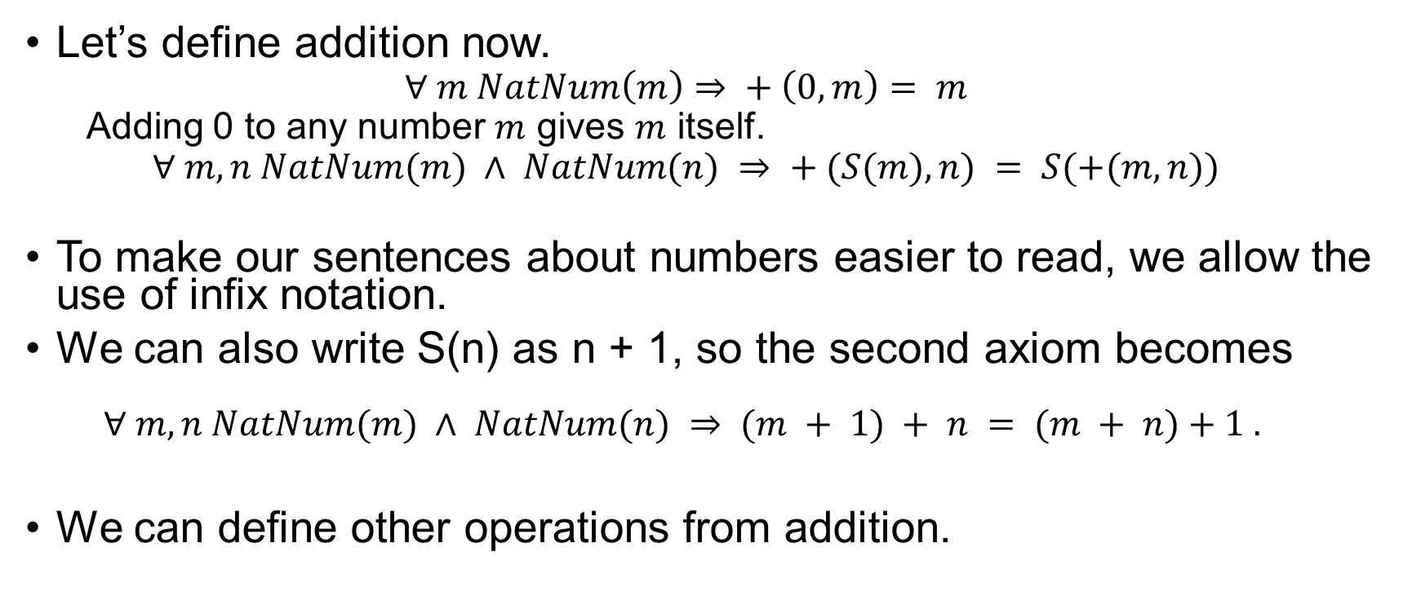
Numbers
Let’s define addition now.
$$∀ m NatNum\left(m\right)⇒ + \left(0, m\right)= m$$
Adding 0 to any number $m$ gives $m$ itself.
$$∀ m, n NatNum(m) ∧ NatNum(n) ⇒ + (S(m), n) = S(+(m, n))$$
To make our sentences about numbers easier to read, we allow the use of infix notation.
We can also write S(n) as n + 1, so the second axiom becomes
$$∀ m, n NatNum(m) ∧ NatNum(n) ⇒ (m + 1) + n = (m + n)+1 .$$
We can define other operations from addition.

Slide 39
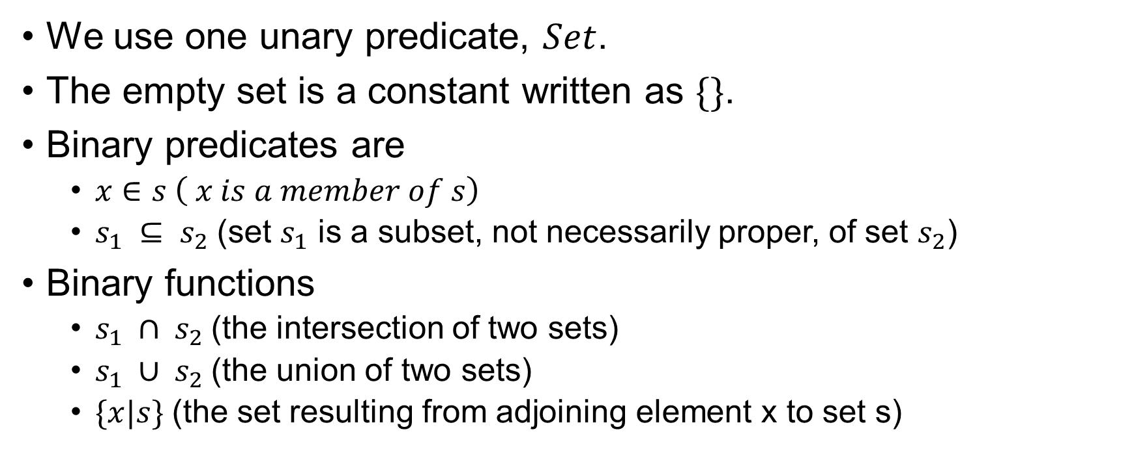
Sets
We use one unary predicate, $Set$.
The empty set is a constant written as $\{\}$.
Binary predicates are
$x∈s \left( x is a member of s\right)$
$s_{1} ⊆ s_{2}$(set $s_{1}$ is a subset, not necessarily proper, of set $s_{2}$)
Binary functions
$s_{1} ∩ s_{2}$(the intersection of two sets)
$s_{1} ∪ s_{2}$(the union of two sets)
$\{x|s\}$(the set resulting from adjoining element x to set s)

Slide 40
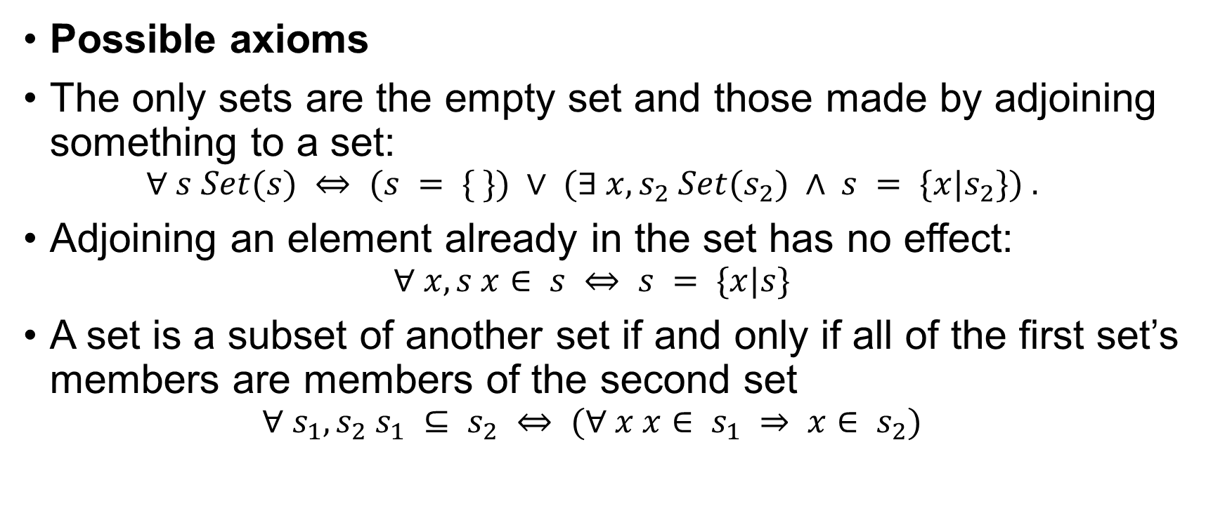
Sets
Possible axioms
The only sets are the empty set and those made by adjoining something to a set:
$$∀ s Set(s) ⇔ (s = \{ \}) ∨ (∃ x, s_{2} Set(s_{2}) ∧ s = \{x|s_{2}\}) .$$
Adjoining an element already in the set has no effect:
$$∀ x, s x∈ s ⇔ s = \{x|s\}$$
A set is a subset of another set if and only if all of the first set’s members are members of the second set
$$∀ s_{1}, s_{2} s_{1} ⊆ s_{2} ⇔ (∀ x x∈ s_{1} ⇒ x∈ s_{2})$$

Slide 41
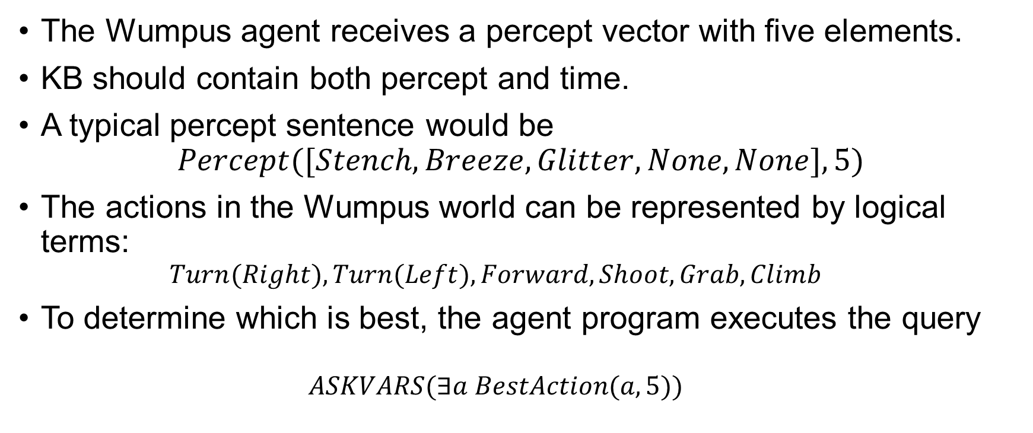
The Wumpus World
The Wumpus agent receives a percept vector with five elements.
KB should contain both percept and time.
A typical percept sentence would be
$$Percept([Stench,Breeze,Glitter,None,None],5)$$
The actions in the Wumpus world can be represented by logical terms:
$$Turn(Right), Turn(Left), Forward, Shoot, Grab, Climb$$
To determine which is best, the agent program executes the query
$$ASKVARS(∃a BestAction(a,5))$$

Slide 42
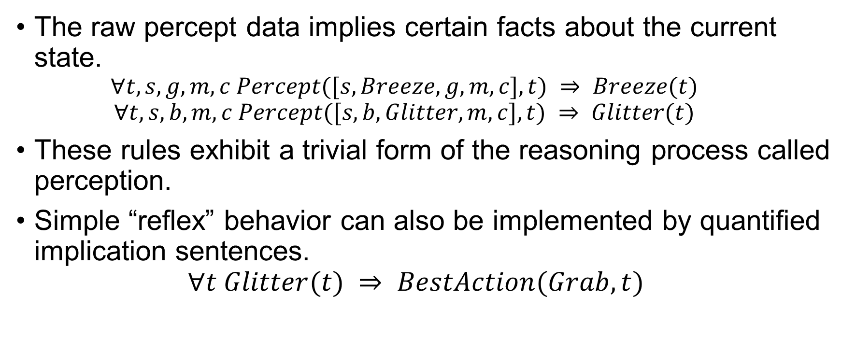
The Wumpus World
The raw percept data implies certain facts about the current state.
$$∀t,s,g,m,c Percept([s,Breeze,g,m,c],t) ⇒ Breeze(t)$$
$$∀t,s,b,m,c Percept([s,b,Glitter,m,c],t) ⇒ Glitter(t)$$
These rules exhibit a trivial form of the reasoning process called perception.
Simple “reflex” behavior can also be implemented by quantified implication sentences. $∀t Glitter(t) ⇒ BestAction(Grab,t)$

Slide 43
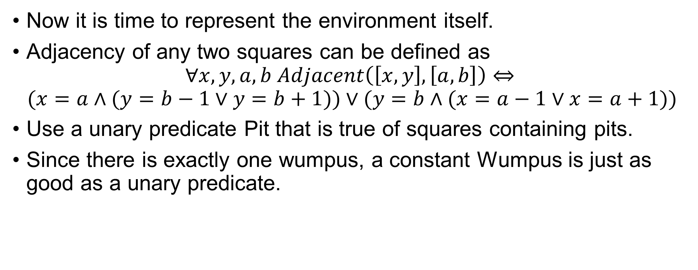
The Wumpus World
Now it is time to represent the environment itself.
Adjacency of any two squares can be defined as
$$∀x,y,a,b Adjacent\left(\left[x,y\right],\left[a,b\right]\right)⇔$$
$$(x=a∧(y=b−1∨y=b+1))∨(y=b∧(x=a−1∨x=a+1))$$
Use a unary predicate Pit that is true of squares containing pits.
Since there is exactly one wumpus, a constant Wumpus is just as good as a unary predicate.

Slide 44

The Wumpus World
We write $At(Agent,s,t)$to mean that the agent is at square s at time t.
We can then say that objects can only be at one location at a time:
$$∀x,s_{1},s_{2},t At(x,s_{1},t) ∧ At(x,s_{2},t) ⇒ s1 = s2$$

Slide 45
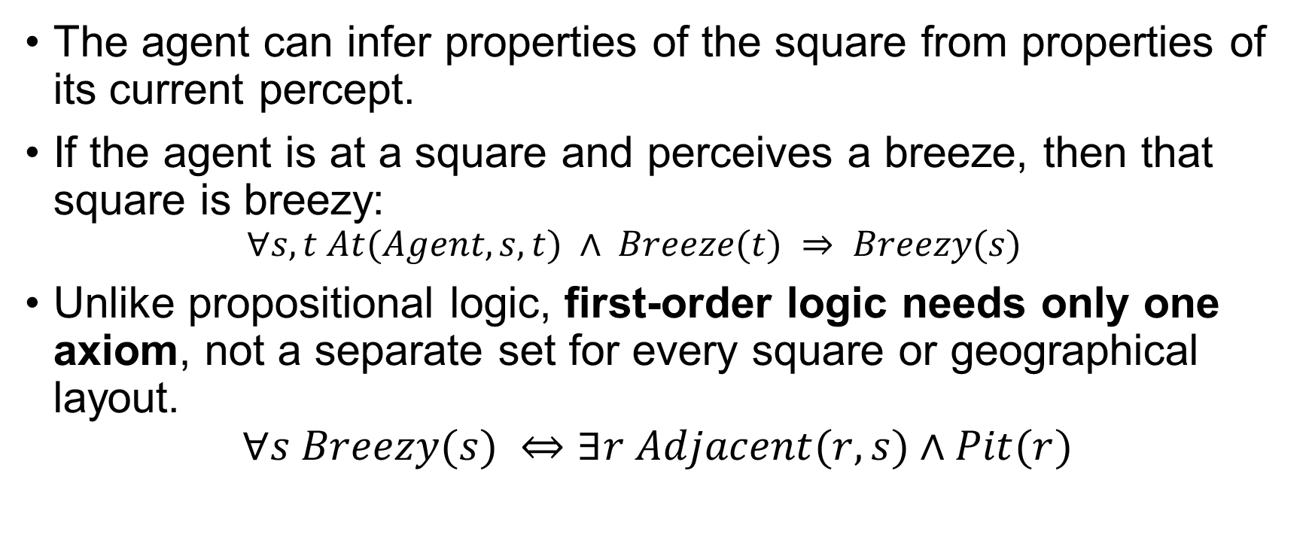
The Wumpus World
The agent can infer properties of the square from properties of its current percept.
If the agent is at a square and perceives a breeze, then that square is breezy:
$$∀s,t At(Agent,s,t) ∧ Breeze(t) ⇒ Breezy(s)$$
Unlike propositional logic, first-order logic needs only one axiom, not a separate set for every square or geographical layout.
$$∀s Breezy(s) ⇔∃r Adjacent(r,s)∧Pit(r)$$

Slide 46

The Wumpus World
We can quantify over time, so we need just one successor-state axiom for each predicate
The axiom for the arrow
$$∀t HaveArrow(t+1) ⇔ (HaveArrow(t)∧¬Action(Shoot,t))$$

Slide 47
Knowledge Engineering
The general process of knowledge base construction is called knowledge engineering.
Consists of seven steps.

Slide 48
Identify the task
Define scope
Delineate the range of questions the KB will answer and specify the facts needed for each problem.
Does the Wumpus knowledge base need to be able to choose actions or is it required to answer questions only about the contents of the environment?
Analogous to PEAS for agent design.

Slide 49
Assemble the Relevant Knowledge
Knowledge Acquisition
Work with domain experts to extract their knowledge (if you aren't an expert).
For Wumpus world it was easy.
Non-formal stage
Focus on understanding the scope and how the domain works.
Relevance Check
Determine which facts are truly necessary for the task (e.g., Is stray capacitance relevant for VLSI simulation?).

Slide 50
Decide on a Vocabulary
Translate Concepts
Convert important domain concepts into formal logic names (predicates, functions, constants).
Ontology
The resulting vocabulary/theory that defines what kinds of things exist in the domain.
Are pits objects or a predicate on squares?
Agent’s orientation is a function or a predicate.
Style is Key
Poor vocabulary choices can negatively impact project success.

Slide 51
Encode General Knowledge
Writes down the axioms for all the vocabulary terms.
Define Terms
Write axioms to pin down the meaning and interrelationships of the vocabulary terms.
Iterative Process
This step often reveals gaps or misconceptions in the vocabulary, requiring a return to Step 3.

Slide 52
Encode Specific Problem Instance
Input Data
Write simple atomic sentences describing the specific situation or problem.
For Agents
Input comes from sensors.
For KB
Input is supplied as facts/sentences (like input data for a traditional program).

Slide 53
Pose Queries and Get Answers
Inference at Work
Use the inference procedure to operate on the axioms and problem-specific facts to derive the desired answers.
Key Benefit
Avoids the need to write an application-specific solution algorithm.

Slide 54
Debug the Knowledge Base
Refinement
Rarely correct on the first try; answers are correct for the KB but may not be what the user expects.
Identify Errors
Missing/Weak Axioms
Reasoning stops unexpectedly (e.g., using a simple conditional (⇒) instead of a biconditional (⟺)).
Incorrect Axioms
False statements about the world, independently of the rest of the KB (e.g., All things with 4 legs are mammals).

Slide 55
The Electronic Circuit Domain
Self Study

Slide 56
Thank You.

